Slide 1
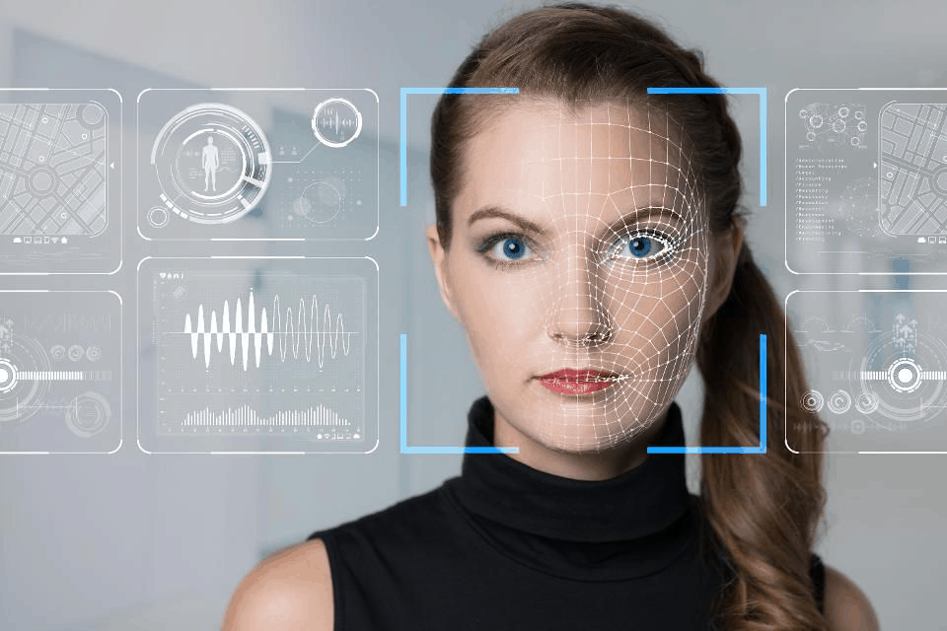
House Safety with Face Recognition using Opencv and Numpy

Slide 2
Problem statement
This is a project made as contribution to the security sector, with the burglary rate still being in thousands and to keep ourselves and our families safe, we serve this project using “face recognition” with opencv and numpy. So, we consider making a project to deal with the security of people entering and leaving the house. We made this project possible by using opencv, numpy (serves main purposes). A source for detecting and having a record of who ever entering the house and preventing the causes for burglary must having be a prioritised methodology.

Slide 3
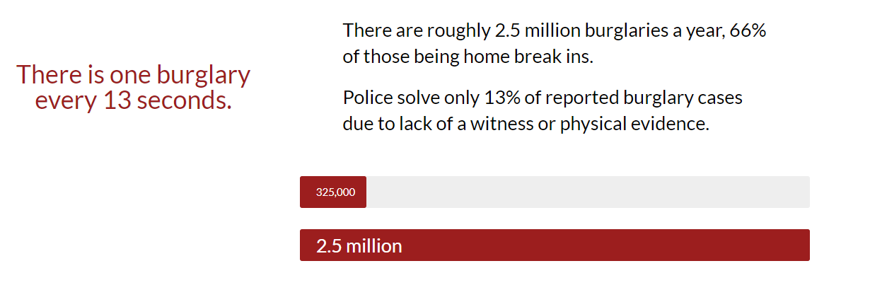
Objective of the project
While today’s burglary statistics show an overall decrease in burglary rates, thousands of homes (roughly 325,000) are still being broken into every year. There are roughly 2.5 million burglaries a year, 66% of those being home break ins.
Police solve only 13% of reported burglary cases due to lack of a witness or physical evidence. Thus, the objective of this project is to prevent break ins like these, and ensure a way to secure our home from miseries like these we initiate a way to have record of all the people coming to our house.

Slide 4
Applications of the project
Main motive of this project to ensure safety for families, kids, old people staying in home even though you are not in a place to help, but can still keep an eye and be notified about it.
No more further updates and necessities required.
Limited and reduced man-labour.
Precision in the results acquired.
Secured information.
Independently trained.
With proper data the information, the model can be updated annually.

Slide 5
Technical background
The project starts with the working of two modules namely, capture_face and model_training. Whether to analyse on a reading a person’s face, the program must be revised the fact of which the face is to be recognised as, and once your face is captured to the computer it can then proceed further. Now, the training of the data is to be started as the data of the face has been provided to the model. The model here is trained so that to notify if the person is known or unknown.
Face capturing model
Training the model

Slide 6
Block diagram of the project
Capture_face
Read face using harcascades
Converting Face colour to grayscale
Face is captured/
Dataset is build.
END
Face not found

Slide 7
Training the
model
Program must recognise face considered in grayscale.
Is face being able to
read?
Match with the dataset if thus us the user?
END
Face not found
Print “unkown”
Print ”it is user”

Slide 8
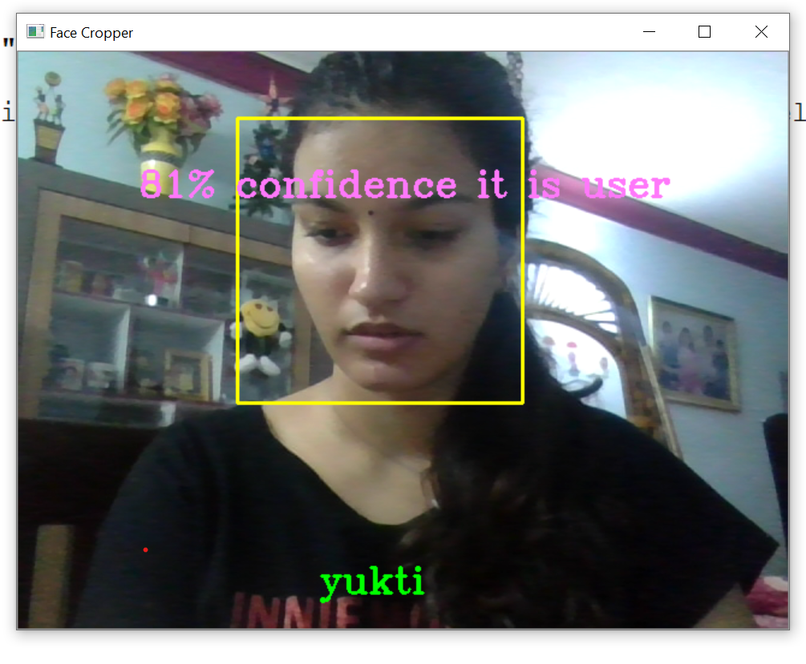
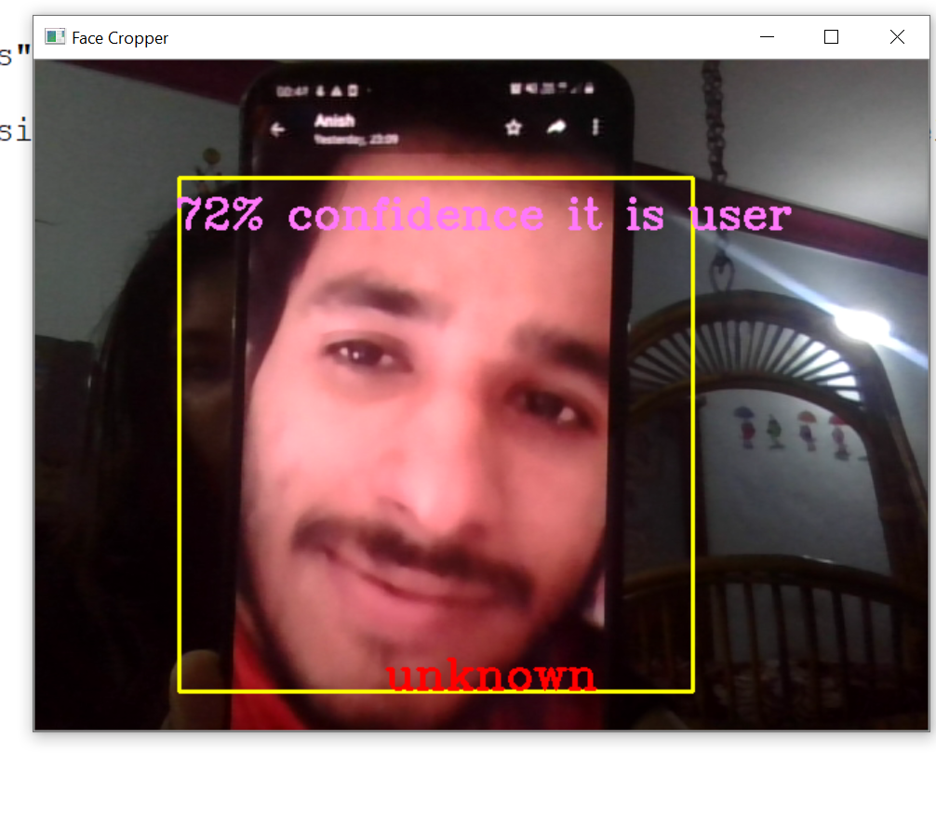
The user/ family:
The outsider/ smuglar:

Slide 9
Future aspects
This is just the software part of the project, we further want to enable this as a full-fledged project with the working of the Arduino, raspberry pie(and other hardwares…) as including the hardware part of the project would require to some resources which is not possible right now.
We can further make interface, like a web application or an android application to further making it accessible and having a record/history of everyday
Further changes like adding more dataset to people with criminal records and having it mentioned can be merrier.
Data can be updated with respect to number of people coming and going, from time to time.

Slide 10
Thankyou!!
Project by:
Yukti Singh
19BAI10015

